Slide 1
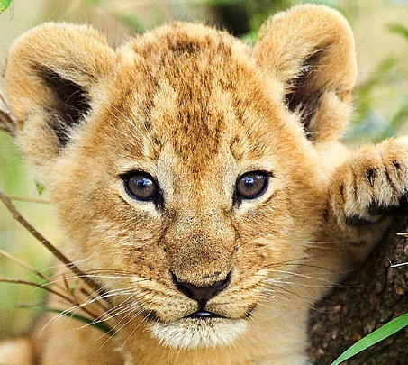
Welcome to 5th Grade
Please feel free
to fill out the volunteer forms that are on the cabinets.
Camons’ Cubs

Slide 2
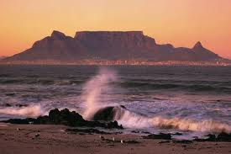
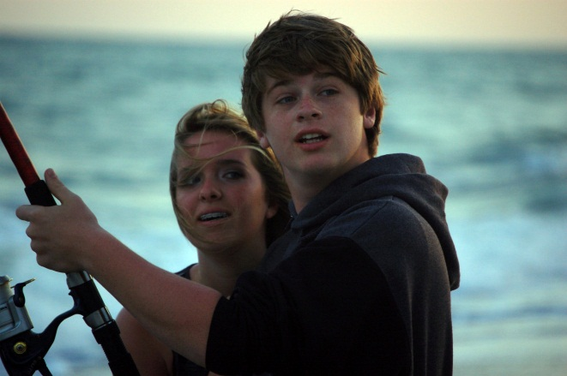
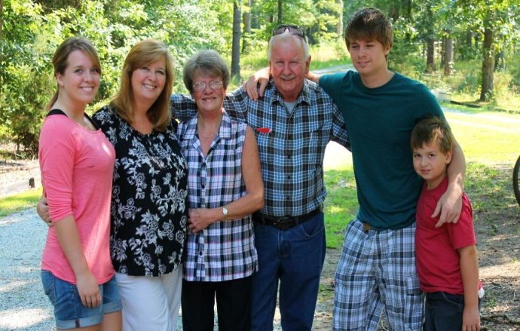
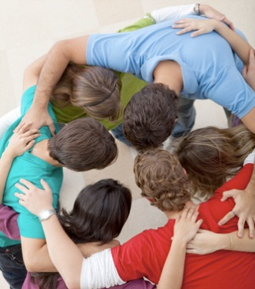
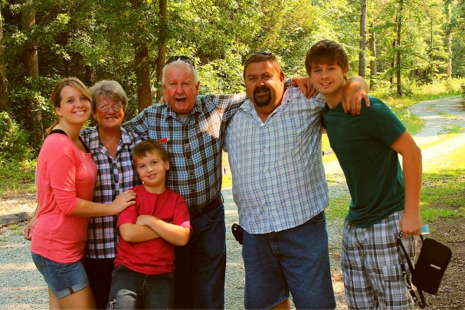
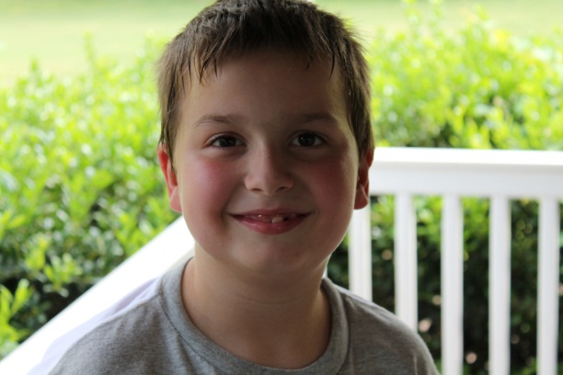
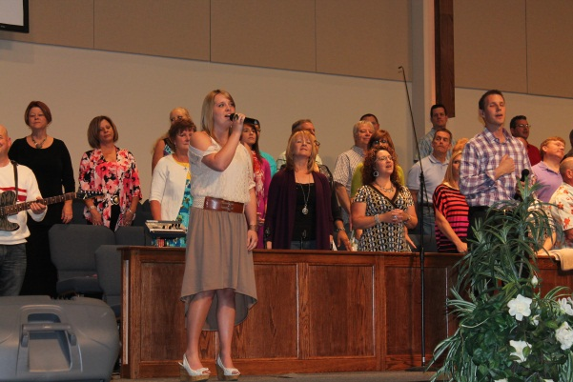
About Me

Slide 3
Contact information
School Phone : (336) 227-0288 x 130
Cell Phone – for emergencies : (336) 675-1504
Email : ccamons@burlingtonchristian.org
Class Website with extra information :
http://mrscamonscubs.weebly.com

Slide 4
What’s on your desk?
Folder with information
Math Text Book
Language Arts Text Book
English Work Book
History Text Book and Work Book
Science Text Book and Work Book
Planner
Please return Emergency Information form by THURSDAY. Please return all other forms that need to be filled in by FRIDAY.

Slide 5
Schedule (Subject to change)
 | MONDAY WEEK 1
8:15 8:45 9:15 10:40 11:00 11:30 12:05 1:00 1:35 2:00 2:45 3:15 | Morning Work Bible Math Break Language Arts P.E. Language Arts LUNCH D.E.A.R Science / History Recess Dismissal
 | MONDAY WEEK 2
8:15 8:45 9:15 10:40 11:00 11:30 12:05 1:00 1:30 2:10 3:00 3:15 | Morning Work Bible Math Break Language Arts P.E. Language Arts LUNCH ART Science / History Recess Dismissal

Slide 6
Schedule
 | TUESDAY
8:15 8:45 9:15 10:40 11:00 12:00 12:40 1:00 1:35 2:00 2:45 3:15 | Morning Work Bible Math Break Language Arts Computer D.E.A.R LUNCH Language Arts Science / History Recess Dismissal
 | WEDNESDAY
8:15 8:45 9:30 10:40 11:00 11:30 1:00 1:35 2:00 2:45 3:15 | Morning Work Spanish Language Arts Break Bible Math LUNCH D.E.A.R Science/History Recess Dismissal

Slide 7
Schedule
 | THURSDAY
8:15 8:45 9:30 10:10 10:40 11:00 11:30 12:50 1:20 2:20 2:50 3:00 3:15 | Morning Work Music P.E. Bible Break D.E.A.R Language Arts LUNCH Math History or Science Recess Pack Up / Read Aloud Dismissal
 | FRIDAY
8:15 8:45 9:30 10:10 10:40 11:00 11:45 1:00 1:35 2:00 2:45 3:15 | Morning Work Bible Library Math Break Math Language Arts LUNCH D.E.A.R Science / History Recess Dismissal

Slide 8
A DAY IN THE LIFE OF A 5TH GRADE CUB
Morning Work
Check Supplies
Brain Building
Bible
Memory Verse
Bible Packet
Unit Test
Projects
Math
Calendar Math
Math Journal
Math Quizzes/Tests

Slide 9
Language Arts
Reading
English
AR/Book Reports
Writing Journal and Vocabulary Journal
Writing Folder
History
Units/Projects
Mini-Economy
Science
Units/Projects

Slide 10
Chapel – Tuesday mornings
Blue/Gray – Yearly competition; End of year celebration
Field Trips
Valuable Information
InfoDirect
Weekly Information – letter with homework
Folders -homework
Binder
Planner
Homework
Project Information
Contacting Me
Text anytime (336) 675-1504
Email ccamons@burlingtonchristian.org
Call BCA ext 130

Slide 11
Arrival and departure Procedures
Students need to be at school by 8:20.
If students are tardy, a parent MUST go to the office with the child to sign them in. If they come to the classroom without a tardy note, they will be sent back to the office.
Morning Care : 6:30 am (7:00 am on the first day)
Afternoon Care : 6:00 pm
When coming to pick up your child as a car rider, please ensure that the manilla card with your family details are clearly seen through the window. This will ensure that pick up goes quickly and smoothly. You can attach it to your visor with a rubber band.

Slide 12
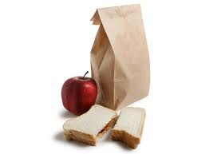
BREAKS AND LUNCH
Breaks are every day from 10:40 – 11:00am.
Lunch is from 1:00 – 1:30pm
Please DO NOT send soda with your student to school. However, if you bring outside lunch when you come and visit your child, you may bring a drink from there. They may not bring it up to the room after lunch.
Feel free to visit your child for lunch whenever you would like to. If your child wishes to have friends eat lunch with them, that is fine, but school policy states that you may not take other students outside to eat.
Please send water with your child to drink in class as needed. Do not, however, send in flavored drinks as we do not want sticky tables and carpets if they should spill.

Slide 13
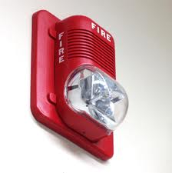
SAFETY
School does regular fire drills, tornado drills (in the Spring) and lockdowns
Not all doors to the school are unlocked – just those used regularly by students.
All Staff wear ID badges

Slide 14
Classroom management
We are not going to implement classroom rules as such, but will get together as a class on the first few days and come up with a set of GOALS that we feel we should try to achieve daily in class.
For example, if we chose : RESPECT OTHERS as a goal, we would talk about things that we could do that would not respect others, such as shouting out instead of giving every one a turn. This would give the students ownership of the classroom goals, and they would not feel as though they are being told what they SHOULD and SHOULDN’T be doing in class.
1 Peter 4:10 “Like good stewards of the manifold grace of God, serve one another with whatever gift each of you has received.”

Slide 15
Some Tips for your child
Bring a sweater/hoodie to school. Our classroom can get VERY cold sometimes.
Go to bed a little earlier than normal.
Have a good breakfast in the morning. We’re used to eating whenever we want during the summer, and 10:40 (break time) is a long way away from dinner the night before.
Make sure the bags are packed the night before so that there is no rushing or stressing in the morning.
Remind your child to pack their snack and/or lunch in the morning.
If they have questions about homework, have them make a note of their questions and come and ask me as soon as they come into class. I will answer their questions and give them time to work on whatever it was they didn’t understand.

Slide 16
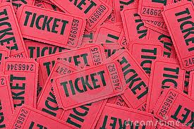
Tickets
If I see students doing something well, (some examples)
Continually raising their hands instead of shouting out
Walking quietly in line
Helping others
Paying attention when I ask, etc
I will give them a ticket and they will write their name on the back of it. It will go into the class bucket, and at the end of the week, I will draw 3 tickets. Those 3 students will get to choose something from the prize box. Everyone else whose name is in the bucket will get 2 free tickets for the following week.

Slide 17
Classroom economy
One of the things we teach in History is about Economy. We will have a mini-economy in class. Students will apply for classroom jobs and will get “paid” for these in class cash. At the end of the month, they will have to pay things like rent, tax, tithes, etc. They will learn how to keep up with a balance sheet to make sure that the amount of cash they have matches up with their sheet.
This is the only area where they can be penalized for bad choices. They will be fined if they don’t follow classroom rules, just like we would be fined if we didn’t follow the law. For example, if a student continually shouts out, after 2 reminders, he/she will be fined $1. If this continues, the fine will increase. Students will get a list of areas where they can be fined.
We will have auctions at various times during the year where students can bid on certain items. This is when they need to make sure they keep track of all their money.

Slide 18
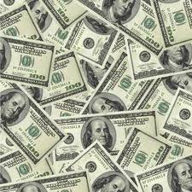
Classroom economy cntd.
Some areas where students may earn debits or fines :
Missing assignments after repeated reminders
No name on paper
Shouting out in class – after reminders
Playing in line when walking from one place to another
Not following class rules

Slide 19
WISH LIST
I have a wish list made up of things that I would love to have in my classroom or items that we will be using this year.
Thank you in advance for giving me the opportunity to teach your child this year. I am VERY excited to get to know each and every one of you. My biggest wish is that your student feels comfortable in my class, and achieves EVERYTHING you could wish for them.
Ephesians 1:16 “I have not stopped giving thanks for you, remembering you in my prayers.”

Slide 20
Calculators
In 6th Grade, students use a TI-30 or 34x calculator. If you would like you buy your child one of these, we will begin using them this year so that they can get used to using them. It is not a requirement though.
If you have any extra calculators lying around the house that you would like to donate, or would like to purchase an extra for the classroom, I would greatly appreciate that ☺

Slide 21
First day of school
Arrive at 8:00am
Depart at 12:00 noon
Arrival and Departure times and locations follow that of the oldest child
*Parents parking during the morning arrival MUST clear
the parking lot by 8:20am
*Students are to be dropped off & picked up as follows:
5th Grade Location Z
*Parents are not to enter the building/classroom to pick up
their child

Slide 22
First day of school
Note: Before School Care will be available beginning at 7:00am in the cafeteria in Building B on Wednesday, August 22nd
. Students may enter the cafeteria through the double doors at the end of Building B. Beginning August 23rd, Before and After School Care will follow the regular schedule.

Slide 23
Questions?
Thank you for coming. Do not hesitate to contact me if you have any questions. ☺

